Slide 1
SALES INSIGHTS
BY,
ASHWATH J
MOJOCARE - DATA ANALYST ASSESSMENT

Slide 2
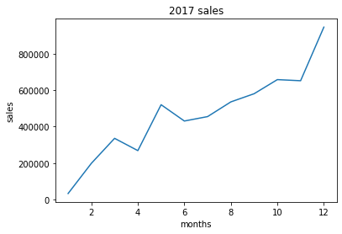
From graph we can see the sales is increasing which signifies the company’s performance.
** Data in year 2016 and 2018 aren’t consistent.

Slide 3
TOTAL ORDERS
City SAO PAULO has the highest number of orders of 17808.
Zip-code 22790 has the highest number of orders of 154.
State SP has the highest orders of 47449.
TOTAL SALES
City SAO PAULO has the highest sales of 1914924.54 and the least is POLO PETROQUIMICO DE TRIUNFO of 5.6.
Zip-code 22790 has the highest sales of 22154.89 and the least is 25907 of 3.54.
State SP has the highest sales of 5202955.05 and the least is RR of 7829.43.

Slide 4
ANALYSIS ON SALES
One of the reason for high sales in SP and least sales in RR is due to the freight expenses.
SP has the least freight expenses of 15.15
RR has the highest of 43
2. Another reason for high sales in SP and least in RR is there delivery time.
Average delivery time in SP is 8.72 days
While RR is 28.33 days.

Slide 5
BEST SELLING CATEGORY
ON ORDERS
The best selling product category is CAMA_MESA_BANHO
The worst selling product category is SEGUROS_E_SERVICOS
ON SALES
BELEZA_SAUDE has the highest sales of 1258681.34
SEGUROS_E_SERVICOS has the least sale of 283.29

Slide 6
BEST SELLING PRODUCT
ON SALES
The product with product_id bb50f2e236e5eea0100680137654686c has the highest sales of 63885.
The product_id with low sales is 46fce52cef5caa7cc225a5531c946c8b has a value of 2.2.
ON ORDERS LEVEL
The product with product id aca2eb7d00ea1a7b8ebd4e68314663af has the highest number of order of 527.
There are 18117 product_id with least number of order of 1.

Slide 7
REPETITIVE CUSTOMERS
11869 customers are repeating in a total of 95420 customers.
12.5% of customers are repeating.
REASON FOR LESS REPETITION
One main factor can be SLA (Service level agreement),which means the expected delivery date given by the company once a product is ordered.

Slide 8
If a delivery is made after the expected delivery date it is considered as SLA breach.(SLA breach directly impacts on CX)
SLA BREACHES ANALYSIS
7.87% of the orders were not delivered on time(7834 of 9944 orders)
Customers facing SLA breaches are not repeating about 85 % of the customers experiencing SLA breaches are terminating.(15.8% are repeating)
One of the major ways to increase our repetition percent is to focus on SLA and try to reduce SLA breaches.

Slide 9
MEDIAN ORDER VALUE
PI has the highest median order value of 99.99
SP has the least of 68.88
MINIMUM ORDER VALUE
AP,RR,SE has the highest min order value of 13.65.
RJ and SP has the least of 0.85
MARKETING CAN BE DONE IN MOV LESS STATES TO INCREASE THERE BASKET VALUE AND THUS INCREASING COMPANY’S REVENUE.

Slide 10
THANK YOU

